Slide 1
Social Studies Subject for Middle School:
Geography and Colonialism
Here is where your presentation begins

Slide 2
Contents of this template
Here’s what you’ll find in this Slidesgo template:
A slide structure based on a multi-purpose presentation for education, which you can easily adapt to your needs. For more info on how to edit the template, please visit Slidesgo School or read our FAQs.
To view this template in PowerPoint with the correct fonts, download and install on your computer the fonts that we have used. You can learn how to download and install fonts here.
An assortment of graphic resources that are suitable for use in the presentation can be found in the alternative resources slide.
A thanks slide, which you must keep so that proper credits for our design are given.
A resources slide, where you’ll find links to all the elements used in the template.
Instructions for use.
Final slides with:
The fonts and colors used in the template.
A selection of illustrations. You can also customize and animate them as you wish with the online editor. Visit Storyset to find more.
More infographic resources, whose size and color can be edited.
Sets of customizable icons of the following themes: general, business, avatar, creative process, education, help & support, medical, nature, performing arts, SEO & marketing, and teamwork.
You can delete this slide when you’re done editing the presentation.

Slide 3
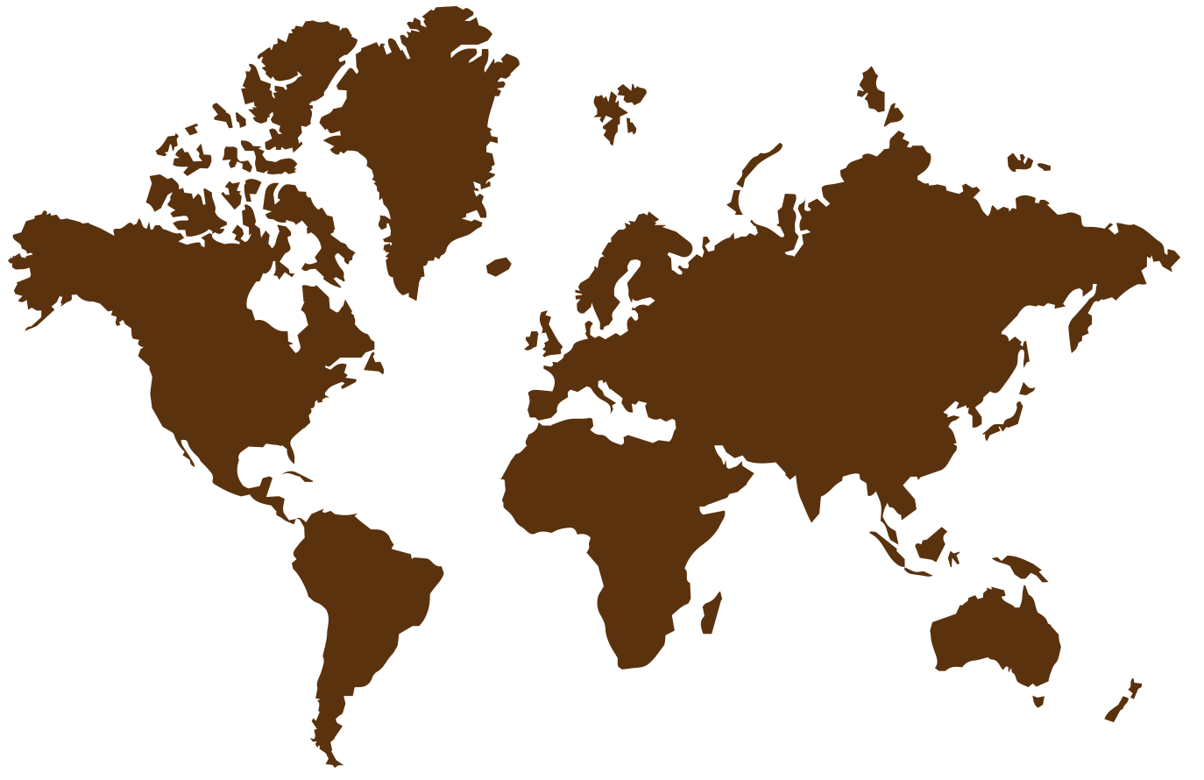
Whoa!
This can be the part of the presentation where you introduce yourself, write your email…

Slide 4
Table of contents
01
02
Geography
History
03
04
Research
Review
You can describe the topic of the section here
You can describe the topic of the section here
You can describe the topic of the section here
You can describe the topic of the section here

Slide 5
Table of contents
Geography
Review
01
04
History
Quiz
02
05
Research
Our team
03
06
You can describe the topic of the section here
You can describe the topic of the section here
You can describe the topic of the section here
You can describe the topic of the section here
You can describe the topic of the section here
You can describe the topic of the section here

Slide 6
01
About geography
You can enter a subtitle here if you need it

Slide 7
About geography and colonialism
Do you know what helps you make your point clear?
Lists like this one:
They’re simple
You can organize your ideas clearly
You’ll never forget to buy milk!
And the most important thing: the audience won’t miss the point of your presentation

Slide 8
Type of geography
Nation
World
Mercury is the closest planet to the Sun and the smallest in the Solar System
Venus has a beautiful name and is the second planet from the Sun

Slide 9
How does geography affect nation?
Income
Agricultural
Transport
Productivity
Venus is the second planet from the Sun
Jupiter is the biggest planet of them all
Despite being red, Mars is a cold place
Saturn is a gas giant and has several rings

Slide 10
What is world geography?
In World Geography Studies, you can examine:
People
Regional
Neptune is the farthest planet from the Sun
Venus is the second planet from the Sun
Places
National
Jupiter is a gas giant and the biggest planet
Saturn is composed of hydrogen and helium
Environments
International
Mercury is closest planet to the sun of them all
Mars is actually a cold place. It’s full of iron

Slide 11
What do you need to know about world geography
Earth’s surface
Human societies
Places can have an impact
How human interacts
Mercury is the closest planet to the Sun and the smallest one
Venus has a beautiful name and very high temperatures

Slide 12
Continents of the world
North America
Europe
Neptune is very far from the Sun
Venus is the second planet from the Sun
South America
Asia
Jupiter is a gas giant and the biggest planet
Saturn is composed of hydrogen and helium
Africa
Australia
Mercury is the closest planet to the Sun
Despite being red, Mars is very cold

Slide 13
United States in the
colonial era
Oregon country
United states
Mexican cession
Thirteen states
Texas
Louisiana
Mercury is very small
Mars is a red planet
Venus is a hot planet
Jupiter is big
We all live on Earth
Saturn is a gas giant

Slide 14
02
About the history
You can enter a subtitle here if you need it

Slide 15
History of colonialism
01
02
03
04
1394
1492
1775
1860
Portugal
Spain
America
Japan
Begins the age of exploration
Age of Spain’s expansion
Colonialism of Britain’s empire
New european colonialism

Slide 16
Types of colonialism
Types | Characteristics
Settler colonialism | Often motivated by religious, political, and economic reasons
Exploitation colonialism | Focuses on the exploitation of natural resources
Surrogate colonialism | Involves a settlement project supported by a colonial power
Internal colonialism | A notion of uneven structural power between areas of a state

Slide 17
Colonists challenges
Drought
Starvation
Threat
Attacks
Disease
Venus is the second planet from the Sun
Mars is actually a very cold place
Jupiter is the biggest planet
Saturn is composed of hydrogen
Neptune is very far from the Sun

Slide 18
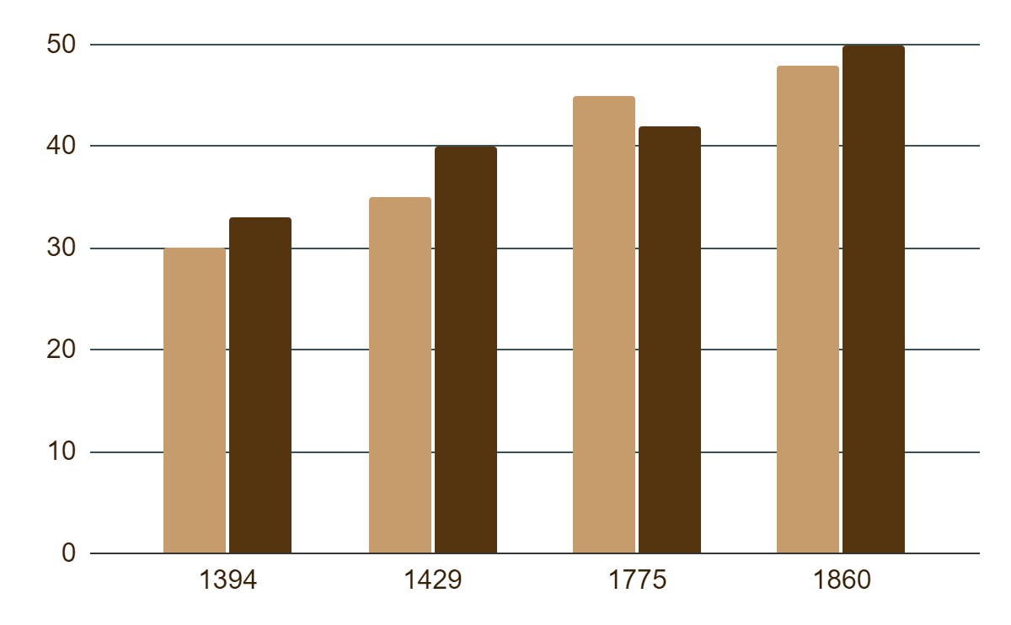
History graph
Colonialism
Jupiter is the biggest planet of them all
Geography
Saturn is composed of hydrogen and helium
Follow the link in the graph to modify its data and then paste the new one here. For more info, click here

Slide 19
Some of the 13 colonies
Connecticut
New York
New Jersey
Virginia
Delaware
Maryland
Mercury is the smallest planet
Venus is the second planet from the Sun
Mars is actually a very cold place
Jupiter is the biggest planet
Saturn is composed of hydrogen
Neptune is very far from the Sun

Slide 20
First colonies in order of establishment
Date | Name of the colony | Famous people
1607 | Virginia | John Smith, John Rolfe
1620 | Plymouth Colony | John Carver, William Bradford
1626 | New York | Peter Minuit, Peter Stuyvesant
1630 | Massachusetts Bay | John Winthrop
1633 | Maryland | George Calvert, Lord Baltimore
1636 | Rhode Island | Roger Williams, Anne Hutchinson

Slide 21
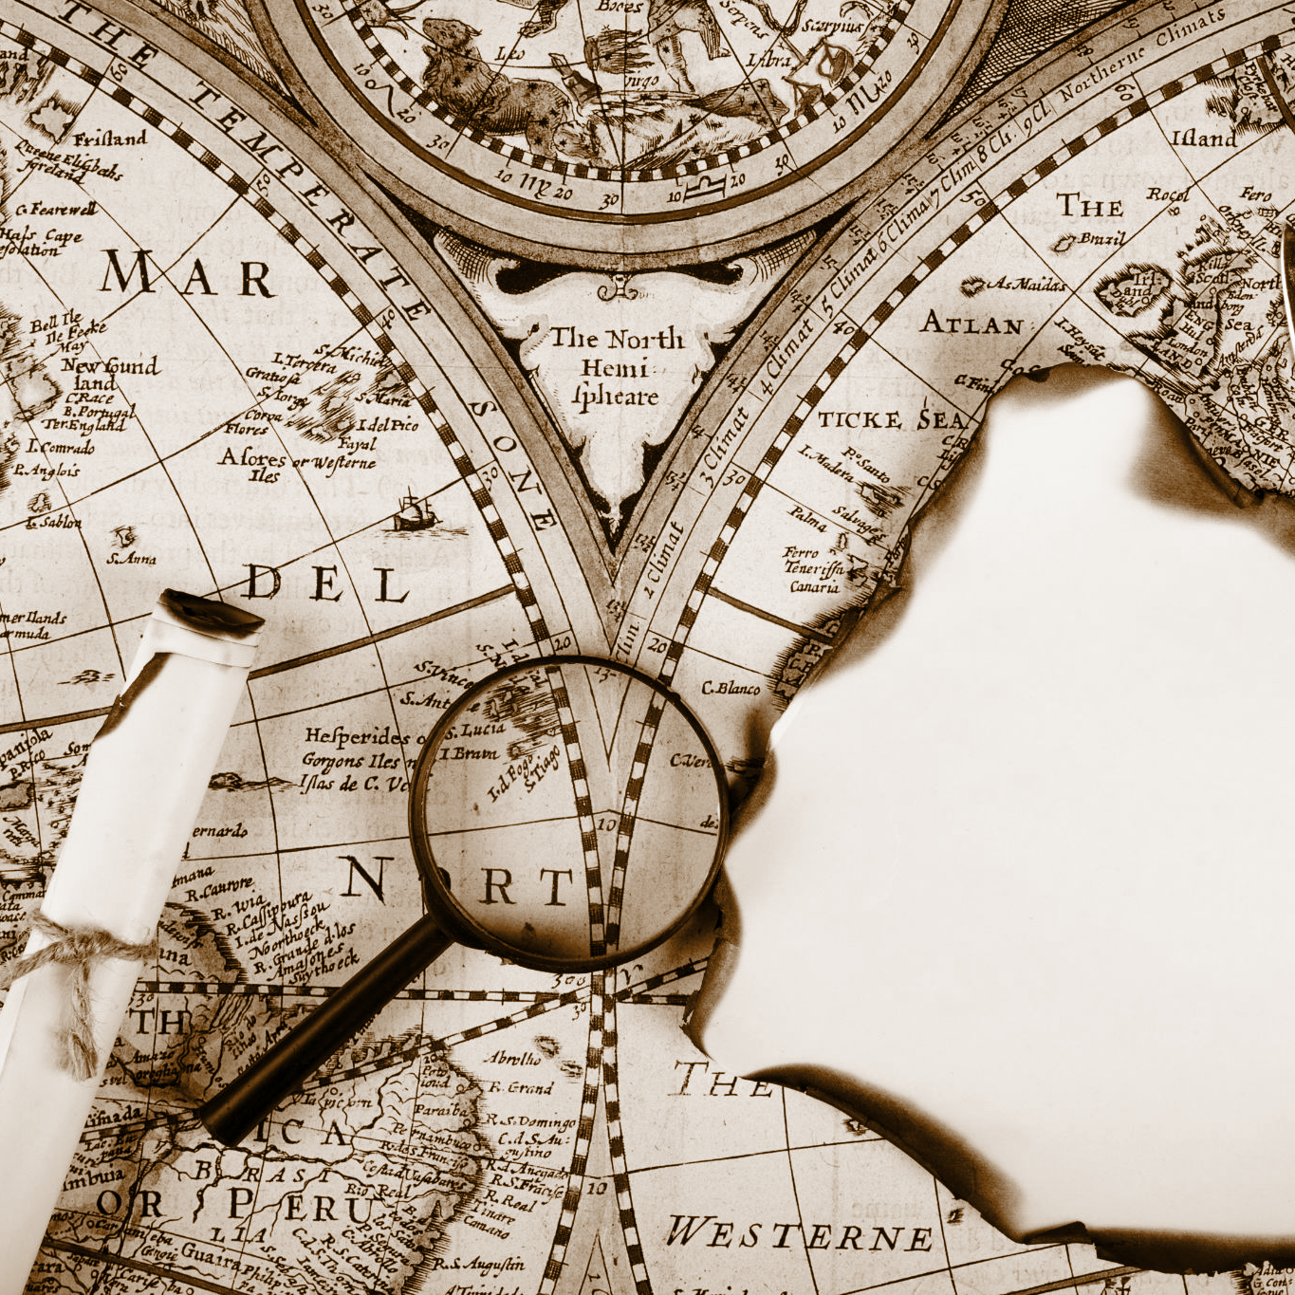
A picture always reinforces
the concept
Images reveal large amounts of data, so remember: use an image instead of a long text. Your audience will appreciate it

Slide 22
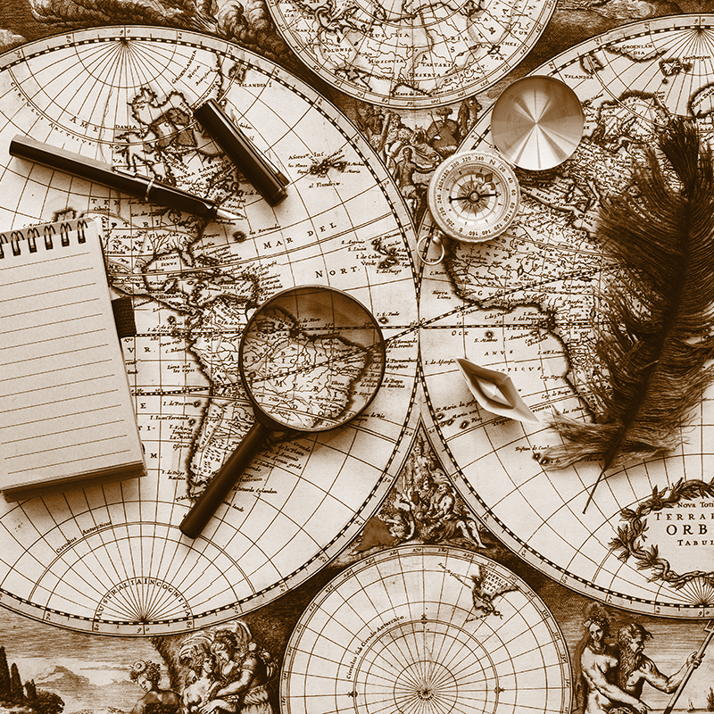
A picture always reinforces
the concept
Images reveal large amounts of data, so remember: use an image instead of a long text. Your audience will appreciate it

Slide 23
Percentages
65%
80%
10%
Mercury
Venus
Mars
Mercury is the smallest planet
Venus is the second planet from the Sun
Mars is actually a very cold place

Slide 24
More percentages
Mercury
75%
Jupiter
65%
Venus
80%
It’s the closest planet to the Sun
Jupiter is the biggest planet of them all
Venus is the second planet from the Sun

Slide 25
Analyzing historical sources
The skill | Action | Question to ask | Answer
Check it over | Mercury Venus | You can write the question here | You can write the answer here
Check the story | Mars Jupiter | You can write the question here | You can write the answer here
Understand the message | Saturn Earth | You can write the question here | You can write the answer here
Examine closely | Moon Sun | You can write the question here | You can write the answer here

Slide 26
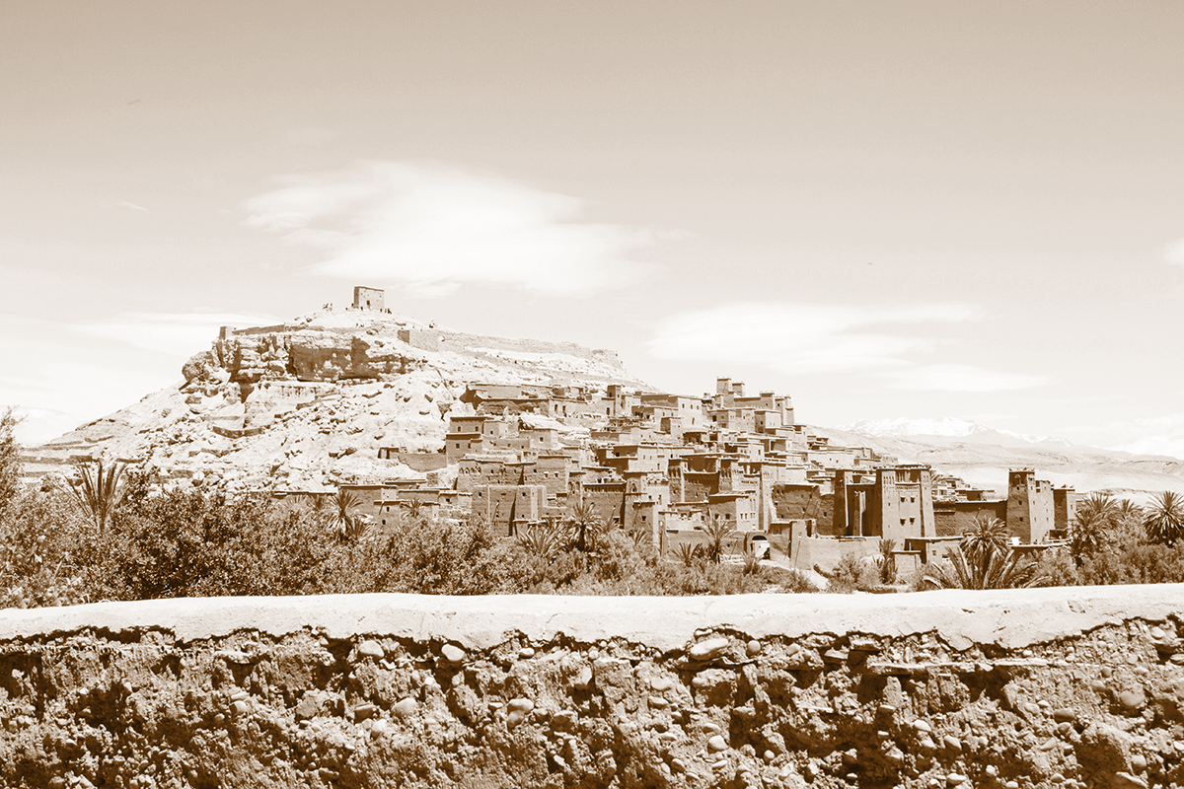
Colonialism documentary
France, 1945
You can replace the image on the screen with your own work. Right click on it and then choose "Replace image" so you can add yours

Slide 27
Book recommendations
The French and Indian War
Sons of Liberty
Mercury is the closest planet to the Sun and the smallest one in the Solar System—it’s only a bit larger than the Moon
Venus has a beautiful name and is the second planet from the Sun. It’s hot and has a poisonous atmosphere

Slide 28
04
Review
You can enter a subtitle here if you need it

Slide 29
Study notes
Write your notes here
Write your notes here
Write your notes here
Write your notes here
Write your notes here
Write your notes here
You can use these study notes
Venus has a beautiful name and is the second planet from the Sun. It’s hot and has a poisonous atmosphere

Slide 30
Important things
The French and Indian War was a major war fought in the American Colonies between 1754 and 1763. The British gained significant territory in North America as a result of the war
You can list your reference websites or publications here
You can list your reference websites or publications here
You can list your reference websites or publications here
You can list your reference websites or publications here

Slide 31
Quiz III: True or false
* Read the sentences and decide if they are true (T) of false (F)
1. | James Oglethorpe founded North Carolina | F
2. | Slaves were only in the southern colonies
3. | Pennsylvania means "Penn's World"
4. | The Dutch and the British had a war
5. | Pennsylvania was actually a land grant gift for William Penn
6. | Massachusetts had/was the first New England Colony

Slide 32
Thanks!
Does anyone have any questions?
addyouremail@freepik.com | +91 620 421 838 yourwebsite.com
Please keep this slide for attribution

